Slide 1
Digital Reputations, Development and Diplomacy
Matt Chessen
@mattlesnake
Office of eDiplomacy
Department of State

Slide 2
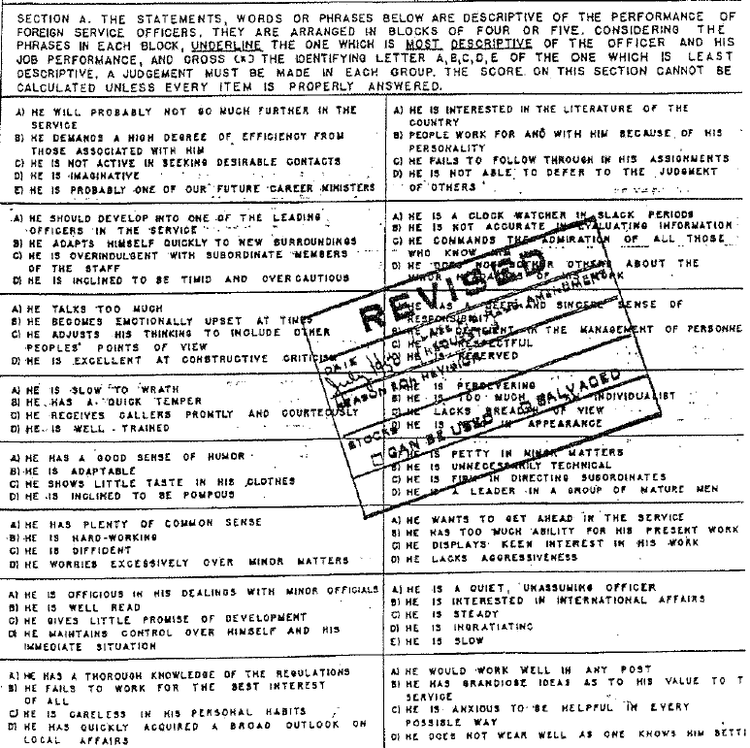

Slide 4
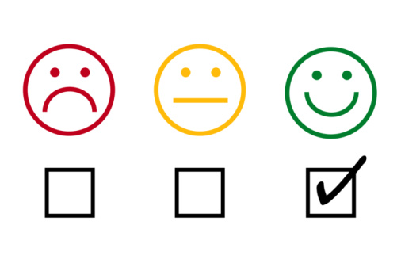

Slide 5
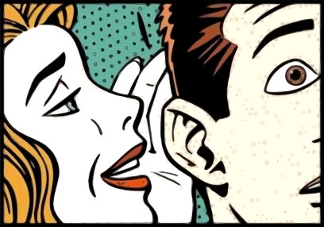

Slide 6
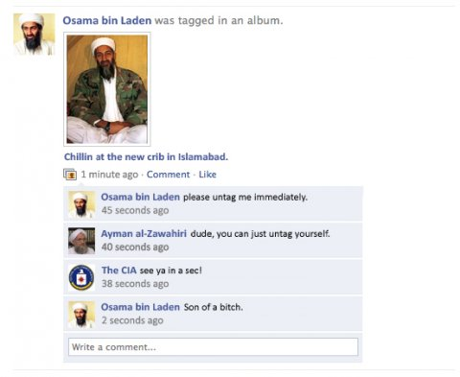

Slide 8
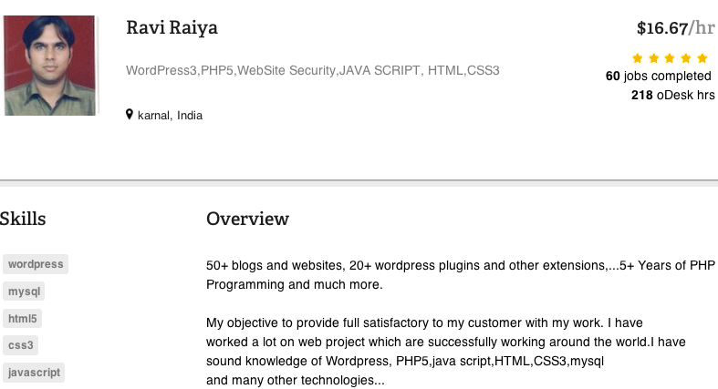

Slide 9
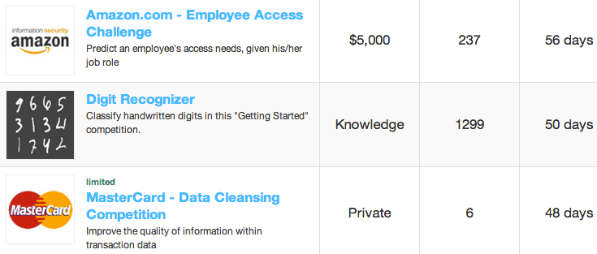

Slide 10
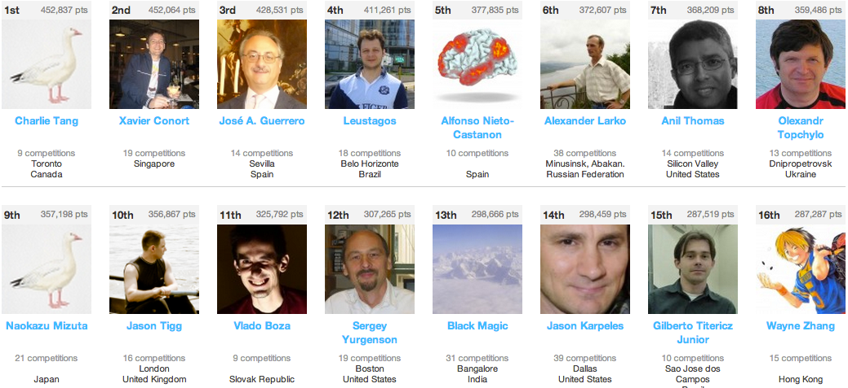

Slide 12
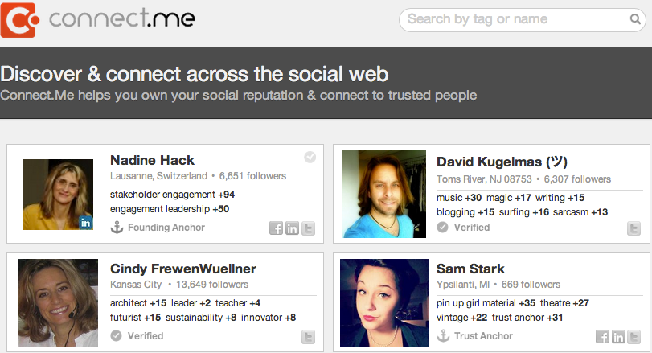

Slide 13
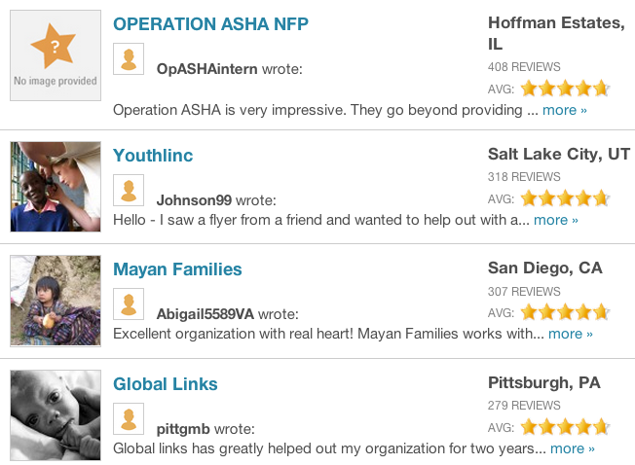

Slide 14
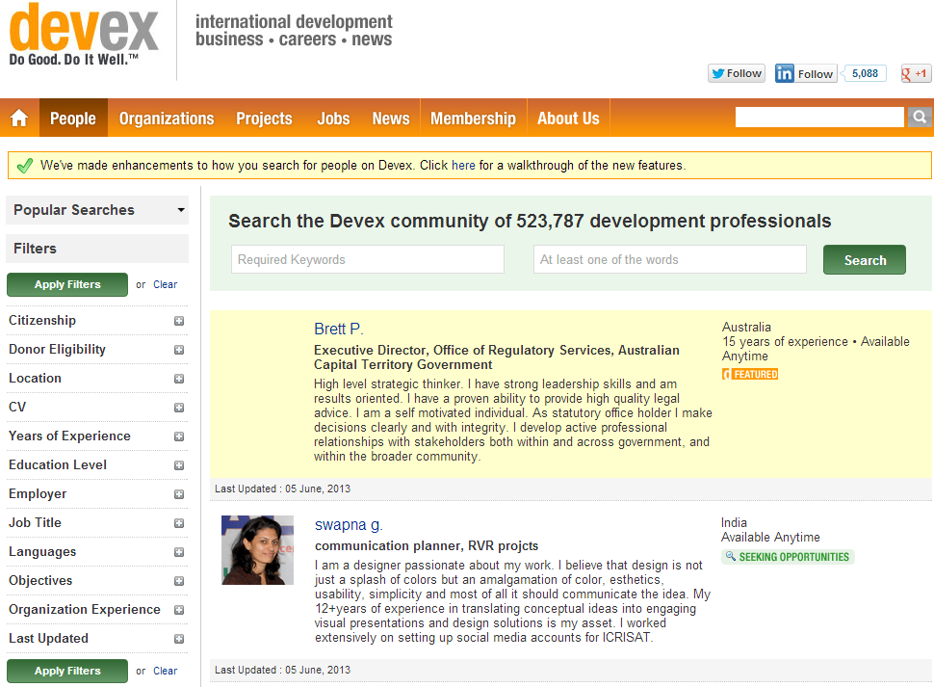

Slide 15
Micro-tasking brings together expertise and opportunity, allowing an organization to tap into the skills it needs.

Slide 16
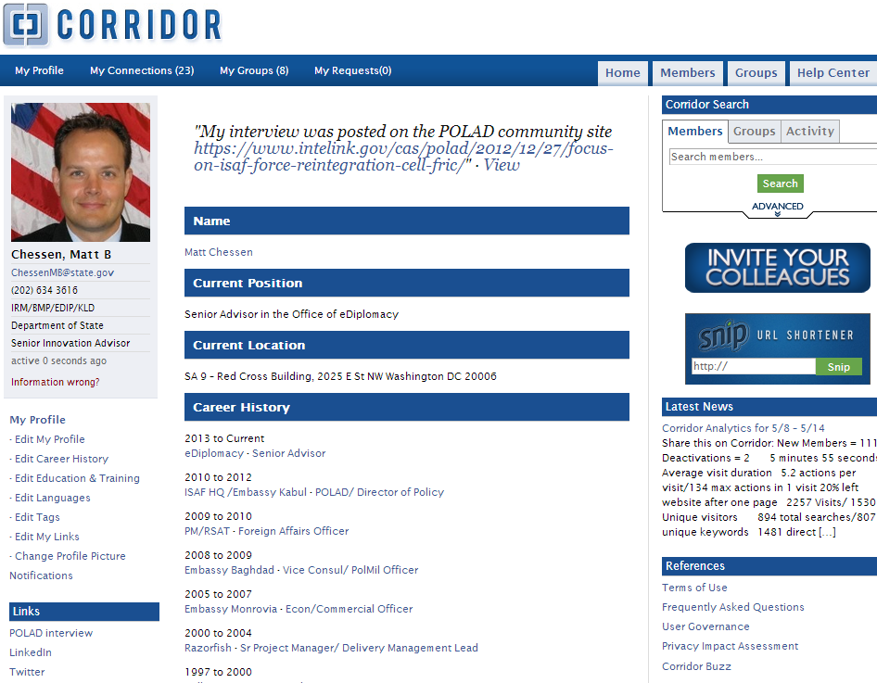

Slide 18
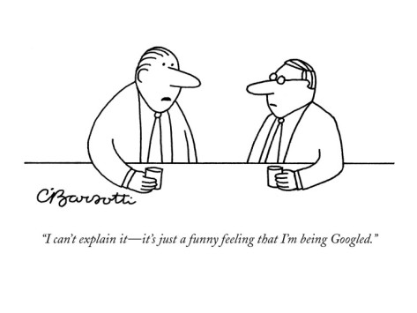

Slide 19
“A good reputation can be used to buy cooperation from others. Even people we have never met.”
-Mark Pagel, Wired for Culture, 2012

Slide 20
